Slide 1
Finding the most cost effective mode to shop - An on-line vs. in-store price comparison analysis
Capstone Intro to Data Science Project
Student - Ming Waters
Capstone Mentor – Goran Milovanovic

Slide 2
Introduction:
More and more consumers are purchasing items on-line versus in-store.
Are consumers benefitting from on-line shopping simply with convenience or are there cost benefits of on-line shopping?
Are there types of products that are best purchased in-store versus on-line?
Would providing a prediction or assessment of where to find the best price for an item be a valuable tool for many consumers? – YES!
This project will use an open source data set, containing price comparisons on-line versus in-store, to determine a recommendation for consumers on where to buy an at the best price.

Slide 3
Approach:
Use Cavallo and Team’s 2016 open source comparison data set to determine which mode of purchase, in-store or on-line, provides the best price. https://dataverse.harvard.edu/dataset.xhtml?persistentId=doi%3A10.7910%2FDVN%2FXXOUHF
Analyze the US data and narrow scope to price comparison of Amazon (on-line) versus in-store.
Wrangle and modify data as needed to perform statistical analysis that will determine if there is a price benefit with purchasing certain product categories on-line versus in-store.
Determine if the total data set shows a better purchasing strategy if the product for purchase is on-sale versus regular priced.

Slide 4
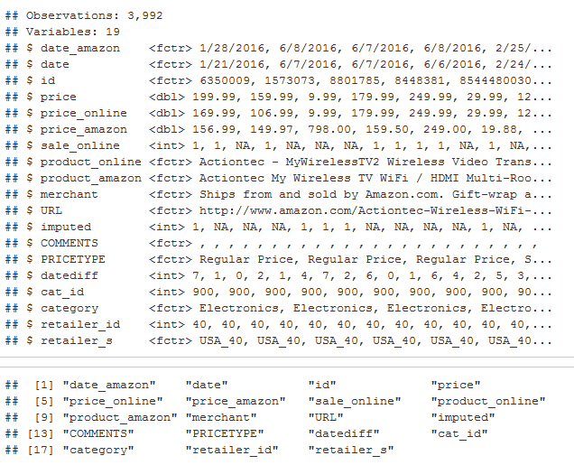
Data Exploration:
The data set used for this analysis contained 3,992 observations with 19 variables; the variables in the blocks were used for this analysis

Slide 5
Additional Variables:
After exploring the data and extracting the data set in R, I realized I needed to compute some additional variables to determine price benefit.
I calculated a percent difference field –
p_difference = (amazon price – price(in-store price)/price
Using the calculated field allows me to equalize the price difference so that larger price deltas for higher priced goods were equal to the smaller deltas for lower priced goods.
I also created category and bias field to analyze best purchased options when the item was on sale or regular priced.
Bias = 0 if price was better on-line, 1 if price was better in store or neutral(same)
Category 1 – Regular price on-line, regular price in-store
Category 2 – sale on-line, regular price in-store
Category 3 – regular price on-line, sale price in-store
Category 4 – Sale price on-line, sale price in-store

Slide 6
Data Wrangling:
The goal of this project was to provide a statistical analysis on the sample set to predict the best purchasing strategy for goods.
Using a sample set to perform predictions of the total population requires
A reasonably sized sample set
Good sampling and fairly normal distributions
The data provided a good sample size but contained multiple data entry and collection errors causing multiple outliers.
Inspection of the product types within the categories also showed multiple pricing duplicates. Many items were priced multiple times versus sampling a broad array of various products within categories. This limited the sampling.

Slide 7
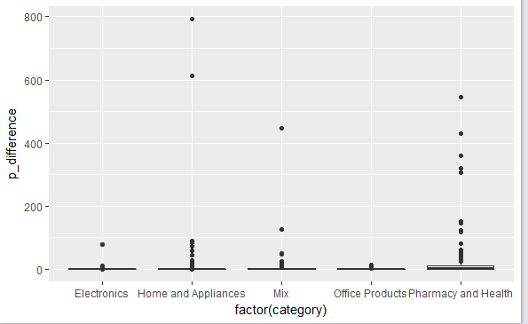
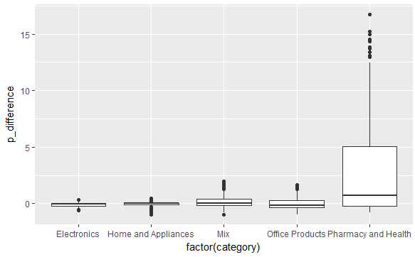
Data Wrangling:
To make the best use of the data, I attempted to clean as many obvious errors as possible using scatter and box plots to view the outliers and the 1.5*IQR (interquartile) method to remove points outside that boundary.
Data Before Wrangling
Data After Wrangling
After significant wrangling and data clean up for each category the upper range of p_difference moved from 800 to 16.

Slide 8
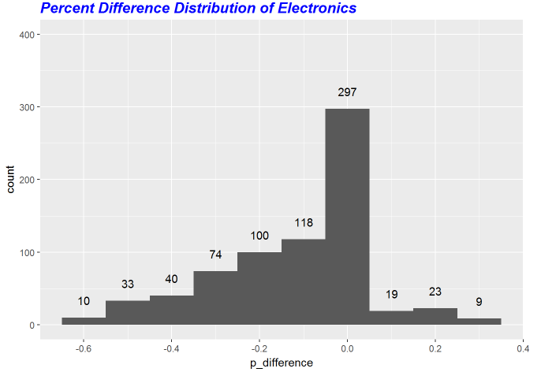
Normality and Analysis :
Even with the data clean up, the data did not meet normality requirements. I decided to pivot from predicting to simply analyzing the data set.

Slide 9
Calculations:
To determine which mode of purchase provided the best price, I created a bias column that coded 0 if the p_difference was less than 0. A negative p_difference indicates the price was better on-line.
If the price was better in the store or matched the on-line price (p_difference >= 0), I coded the value as 1.
I then calculated the mean value of the bias variable for each category. This value provide the percentage of time, items were better or neutral priced in the store.
I used this same approach to calculate the percentages of cost benefits with in-store for my analysis with the price categories(1-4).

Slide 10
Findings:
The analysis of cost benefits by mode of purchase resulted in-
Electronics = 23.65% better pricing in-store
Home Products = 51.02% better pricing in-store
Mix Products = 53.04% better pricing in-store
Office Products = 36.99% better pricing in-store
The analysis of cost benefits by category resulted in –
Cat 1 = 43.09% better pricing in-store
Cat 2 = 26.14% better pricing in-store
Cat 3 = 68.18% better pricing in-store
Cat 4 = 38.18% better pricing in-store
The only category to show better pricing in-store was category 3 which is sale in-store but regular price on-line.

Slide 11
Conclusions and Recommendations:
The overall the best approach to purchasing electronics and office products is to shop on-line at Amazon.
For the other categories, if the product is not on-sale in the store, it is best to begin your price shopping on-line.
Next Steps for better analysis and prediction –
Improve sampling and data quality –
Sample various ranges of products across categories – Sample all types of electronics to ensure pattern is the same across the category or if the distributions normalize.
Control Data Quality – Sample less items but validate entry and scrapped values before using data in analysis set.
Predicting the best mode of purchase to save money is a valuable tool for many consumers.
I would recommend following the steps above to recreate another data set that has better sampling and quality control and then run multinomial logistic regression to see which category or price category would correlate the best to price difference.

